Slide 1

Speak Fluently & Confidently B1- Course 1

Slide 2
Session 1- Talking about Money
Part 1-: At the Post Office and Bank (Listening)
Part 2: What would you say in the following
situations? ( Idioms & collocations)
Part 3: Speaking Practice
https://befluent.me/

Slide 3
Session 1-Talking about Money
Part 1-: At the post Office and Bank
( Listening )
https://befluent.me/

Slide 4
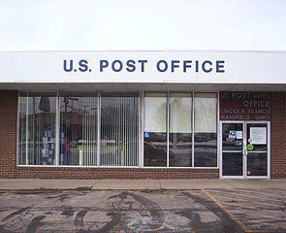
Lesson 1: At the Post Office and Bank
Welcome to Lesson 11 of the Everyday English Speaking Course! Today we’re going to run some errands. “Errands” are activities of daily life that you do outside your house – for example, going to the bank and going to the store.
First, let’s go to the post office – that’s the place where you can send mail and
packages.
Conversation #1 – At the post office
Attendant: Good morning.
David: Good morning – I’d like to mail this package to Mexico.
Attendant: Do you want to send it first- class, priority, or express?
David: What’s the difference?
Attendant: First-class will get there in 15-18 business days, priority in 8-10 business days, and express in 2-3 business days.
David: First-class is fine – it’s not urgent. Can I get a tracking number for the package?
Attendant: Sorry – only with express mail.
David: I’ll stick with first class.
(= I’ll continue with my decision to send it first class)
Attendant: Would you like to add insurance or delivery confirmation?
David: No, that’s OK.

Slide 5
Attendant: I’ll just need you to fill in this customs form.
David: Sure. How much does it cost to mail postcards?
Attendant: 32 cents each.
David: Then I’d like to mail these 10 postcards, too.
Attendant: All right. Would you like to buy any stamps or envelopes today?
David: No thanks.
Attendant: OK. Your total is $33.70.
Conversation Vocabulary & Phrases
The word “mail” can be a noun or a verb. “Mail” as a noun refers to the letters and magazines you receive. “Mail” as a verb means to send something through the post office system.
At the post office, you’ll probably have a choice of several sending
options. First-class mail is the slowest and cheapest option; priority mail is a little faster and a little more expensive, and express mail is the fastest, most expensive option. Some post offices also offer overnight delivery, which means it’s guaranteed to arrive the next day.
Business days are Monday, Tuesday, Wednesday, Thursday, and Friday (except for major national holidays).
A tracking number is a number that identifies the location of the package. You can put the tracking number into the post office website to find out where the package is, or if it has already been delivered.
You can also get insurance – this means you would receive money as compensation if your package got lost or destroyed in the mail – or delivery confirmation – that’s a service that notifies you when the package is delivered.
Finally, you can also buy stamps and envelopes at the post office:

Slide 6

An envelope (with a letter inside) and a stamp
Notice the attendant’s pronunciation in the questions starting with, “Would you like…” – it sounds like wudjalike
Let’s practice and review the post office phrases:
“I’d like to…
mail/send this package.
mail/send some letters.
mail/send some postcards.
buy some stamps / envelopes.
add insurance / delivery confirmation
send it overnight. It’s urgent.
“Can I get a tracking number for the package?”
“When will it arrive?”
Conversation #2 – At the Bank
Before we go to the bank, let’s learn some money vocabulary! As in most countries, the United States has two types of money – paper money (called bills) and metal money (called coins).
Don’t confuse “coins” with “cash” – cash includes both bills and coins; it is used to distinguish paying with physical money from paying with a credit card or check. This diagram will help:

Slide 7
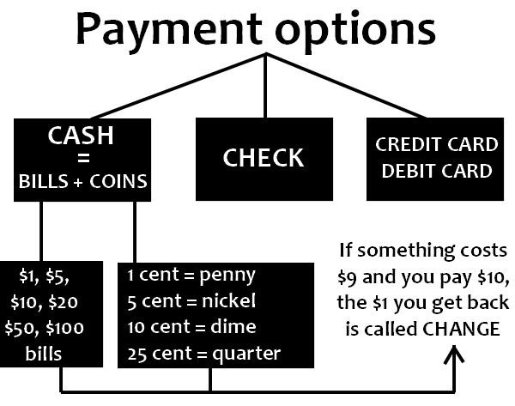
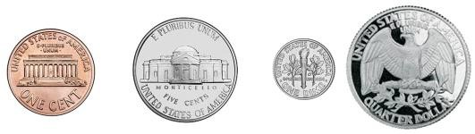
In the U.S., the different coins have different names:
The 1-cent coin is called a penny
The 5-cent coin is called a nickel
The 10-cent coin is called a dime
The 25-cent coin is called a quarter.
There is also a 50-cent coin called a half-dollar, but it’s not very common.
Penny, nickel, dime, and quarter
Canada, Australia, and New Zealand also use the system of dollars and cents. In the United Kingdom, however, the unit of currency is the pound and each pound is made of 100 pence.

Slide 8
If you’re visiting an English-speaking country, you’ll probably want to change money (or exchange money) from one currency into another. Let’s listen to an example conversation about changing money at the bank. The person who works with customers at the bank is called a bank teller.
Teller: Hi, what can I do for you today?
Robert: I’d like to change some money – could you tell me the exchange rate for Euros to dollars?
Teller: One Euro is worth $1.25 – and there’s also an exchange fee of 2%.
Robert: Here’s 300 Euros.
Teller: That’ll be $375, minus the fee gives a total of $367.50. Would you like that in
large or small bills?
Robert: Small bills, please.
Teller: Okay, here’s $200 in 20s, $150 in 10s, $17 in 5s and 1s, and fifty cents.
Robert: Thanks!
Conversation Vocabulary & Phrases
The exchange rate tells you how to convert from one country’s currency to
another – for example, 1 Euro to $1.25, or $1 to 4.5 Argentine pesos.
The expression “Could you tell me…” is a polite way to ask for information. It is more indirect and more polite than saying just “Tell me…” or “I want to know…”
Also, in this conversation as well as in the post office dialogue, the man uses the phrase “I’d like to…” instead of “I want to…” – again, because it is more polite.
The teller may ask if you want your money in large or small bills. Large bills would be $50 or $100 bills, and small bills would be 20s, 10s, 5s, and 1s.

Slide 9
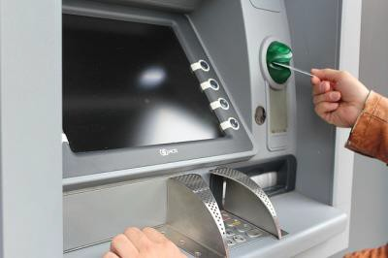
In addition to exchanging money, here are a few more things you can do at the bank:
“I’d like to…
open a checking/savings/investment account.
checking account = for day-to-day expenses
savings account = for keeping money for a long time investment account = for putting money into the stock market
make a deposit / make a withdrawal.
= put money into / take money out of the account.
deposit a check.
= put the money from a check into the account.
cash a check.
cash a check = exchange a check for money
take out a loan.
= borrow money from the bank, to pay back later
check my balance.
= find out how much money you currently have in your account.
talk to a manager about a problem with my account.
If you want to find a machine to withdraw (take out) money, you can ask somebody:
“Is there an ATM around here?”
“Where’s the nearest ATM?”
Another question you might want to ask an employee of the bank is: “Does this ATM accept international cards?”
Now try the quiz to test your vocabulary from the banking and post office phrases.

Slide 10
Quiz – Lesson 11
Can you give me a number?
mailing
posting
tracking
I'm going to England, so I need to change my dollars to _.
pence
pennies
pounds
Could you me where the post office is?
speak
talk
tell
My credit card's not working, so I'll have to pay .
coins
cash
change
How much does it cost to add delivery ?
information
notification
confirmation
Do you have a I can borrow? This candy costs 25 cents.
dime
quarter
nickel
Today's my lucky day! I found a 10-dollar on the sidewalk.
dime
coin
bill

Slide 11
Please send it with mail - it needs to get there fast.
urgent
express
first-class
Overnight mail will arrive the next day.
post office
business
busy
Excuse me, is there an around here?
ATM
ITM
ETM
to mail this letter.
I'd like
I want
I would
I have $5,000 in my savings .
account
check
deposit
Mr. and Mrs. Hughes took out a to buy their car.
balance
lend
loan
Someone made an unauthorized from my account! I need to call the bank right away!
investment
exchange
withdrawal

Slide 12
I need a bigger to mail these documents.
folder
envelope
stamp

Slide 13
Lesson 11 Quiz - Answers
1.C 2.C 3.C 4.B 4.C 6.B 7.C 8.B 9.B 10.A 11.A 12.A 13.C 14.C 15.B

Slide 14
Session 1- Talking about Money
Part 2: What would you say in the following
situations? ( Idioms & collocations)
https://befluent.me/

Slide 15
Session 1-Social Media and the Internet
ATM – cash machine
to withdraw money – to take money from a bank account
cheque – a printed piece of paper that you can use instead of money
transaction cost – an amount that bank or credit company charges for using a bank card
to handle cash – to receive and give money in business
cryptocurrency – a digital currency
salary – a fixed amount of money that your employer pays you every month for the work you do
to borrow the money – to receive money from someone
to lend the money – to give money to somebody
to inherit – to receive money and/or other valuable things from someone who has died
assets – something valuable that a person or company owns
https://befluent.me/

Slide 16
Session 1-Social Media and the Internet
to charge – to ask someone to pay money for services or goods
to overcharge – to ask someone to pay too much money for something
to put some money aside for a rainy day – to save money weekly or monthly for a day when you need it
to splash out money – to spend a lot of money
to fritter away – to spend money without really knowing where you spend it
to be broke – to have no money
to be ripped off – to be charged too much money for something, to be overcharged
to tighten your belt – to spend less money
economic – related to the economy or business
economical – not spending or costing a lot of money
https://befluent.me/

Slide 17
Session 1- Talking about Money
Part 3: Speaking Practice
https://befluent.me/

Slide 18
Session 1- Talking about Money
Do you know anyone that owns their own business? What do they do?
Have you considered running your own business? What kind of business would you like to run?
How is 'business English' different from general English?
What is business sense, and do you have it?
Would you rather work for a big company or a small company? What are the pros and cons of each situation?
Some children are expected to work in their parents' business. Is it good to give childrenpractical businessexperience at an early age? Why or why not?
Have you ever played the board game Monopoly? Is it a good way toteach children about commerce? Can you think of other fun ways tolearn about business?
https://befluent.me/

Slide 19
Session 1- Talking about Money
Business is important in today's economy. Is business education emphasized enough in school?
What is appropriate business attire? Should a businessman wear a tie to be taken seriously? How should a woman in business dress?
. Capitalism is the main system of economic interaction in the world today. What are its advantages and disadvantages?
Who is your favorite entrepreneur? What did they do?
What are the world's greatest companies?
Which company has the worst reputation? Why?
Do you prefer to support local businesses over global corporations? If so, give an example.
Should the government do more to support small businesses and start-ups? What could they do?
Do corporations have too much influence over government?
Which types of business have the brightest future?
https://befluent.me/

Slide 20
Session 1- Talking about Money
Thank you!☺
https://befluent.me/

